Slide 1
Class Distinction Correlation Analysis Revised Version
Kamala Natarajan

Slide 2
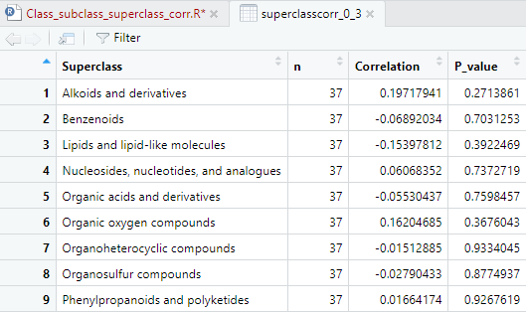
Superclass Classification (0-3)

Slide 3
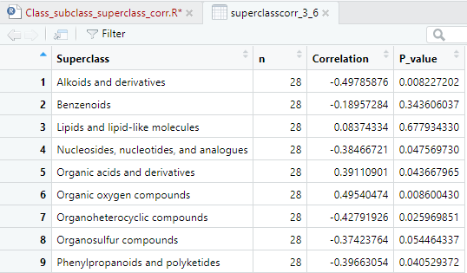
Superclass Classification (3-6)

Slide 4
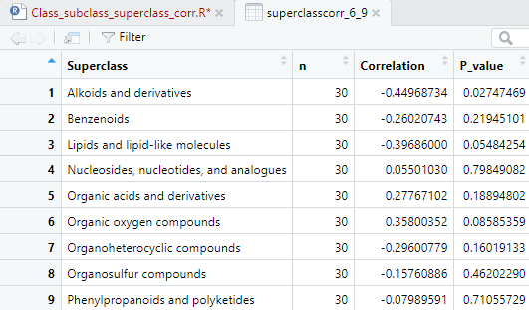
Superclass Classification (6-9)

Slide 5
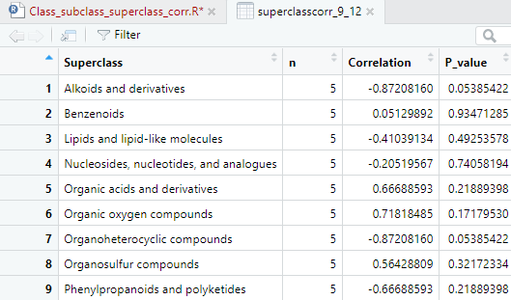
Superclass Classification (9-12)

Slide 6
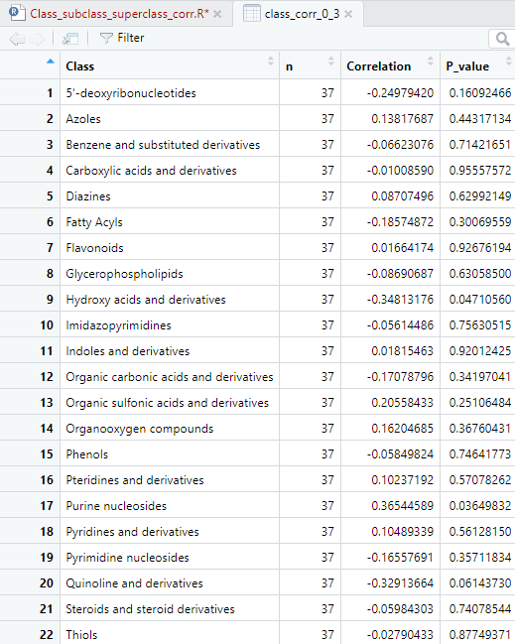
Class Correlations 0-3 Days

Slide 7
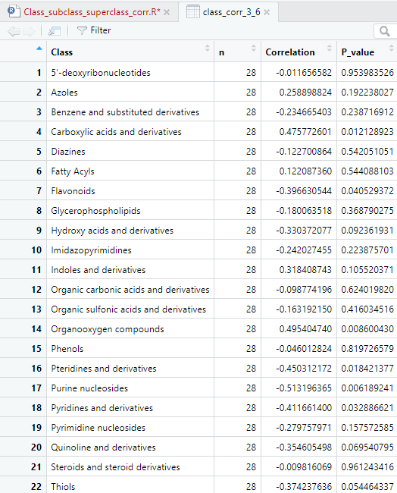
Class Correlation 3-6 Days

Slide 8
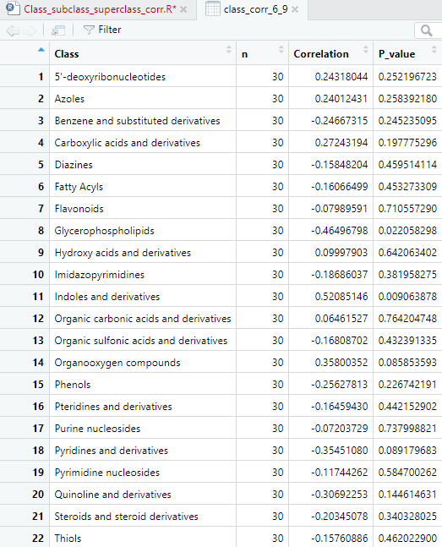
Class Correlation 6-9 Days

Slide 9
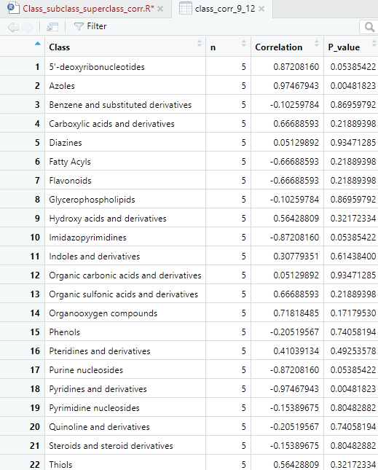
Class Correlation 9-12 Days

Slide 10
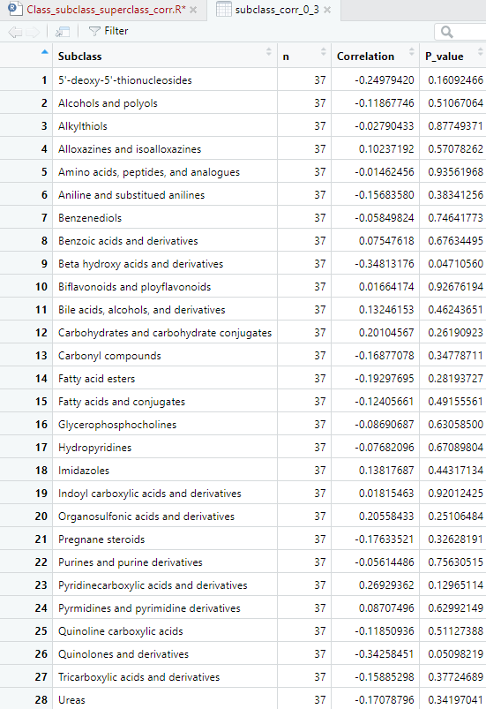
Subclass Correlation 0-3 Days

Slide 11
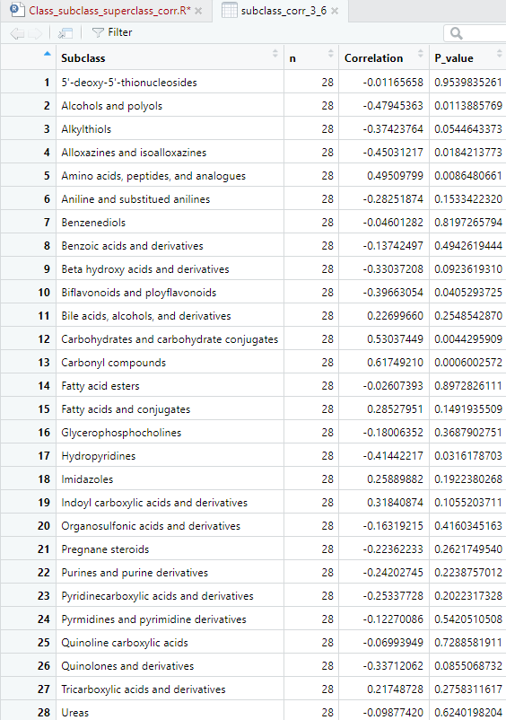
Subclass Correlation 3-6 Days

Slide 12
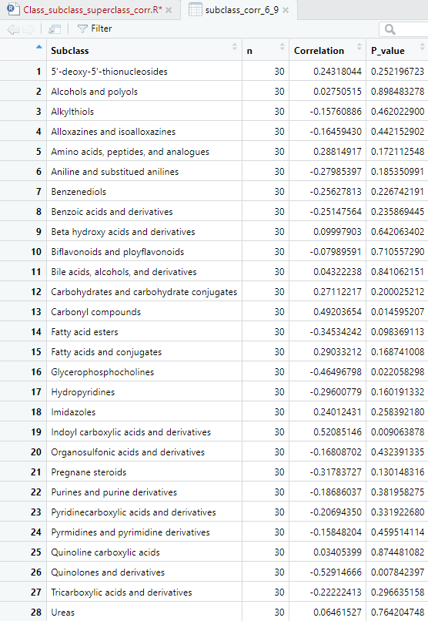
Subclass Correlation 6-9 Days

Slide 13
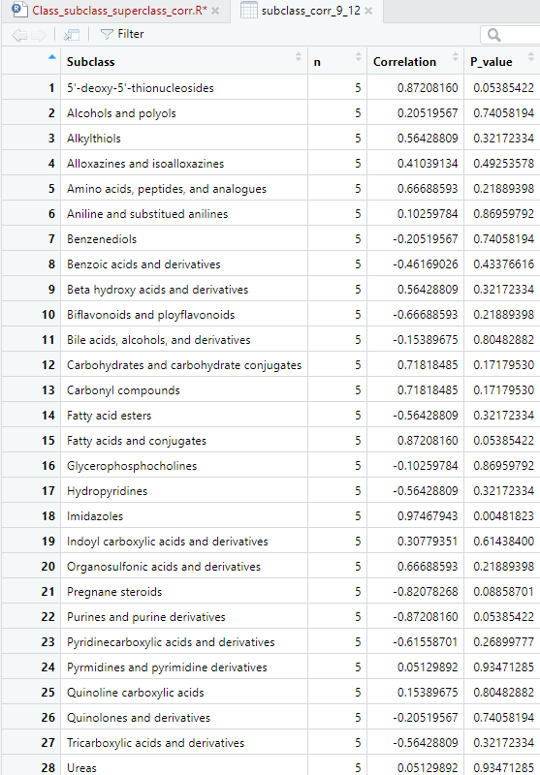
Subclass Correlation 9-12 Days

